Slide 1
SVM
Intuition behind the method

Slide 2
SVM for classification
The classification problem: given a set of observations (vectors in the feature space) assign each point to one of two classes.
If more classes are involved…
The convention in matlab is to use the labels –1 and 1 for the two classes.
The SVM binary classification algorithm searches for an optimal hyperplane that separates the data into two classes.
For separable classes, the optimal hyperplane maximizes a margin (space that does not contain any observations) surrounding itself, which creates boundaries for the positive and negative classes.
For inseparable classes, the objective is the same, but the algorithm imposes a penalty on the length of the margin for every observation that is on the wrong side of its class boundary.

Slide 3
Feature Space and Actual Space
The objects for which the classification is performed are characterized in a real space
The feature space used for classification may be different, but derived from the actual space

Slide 4
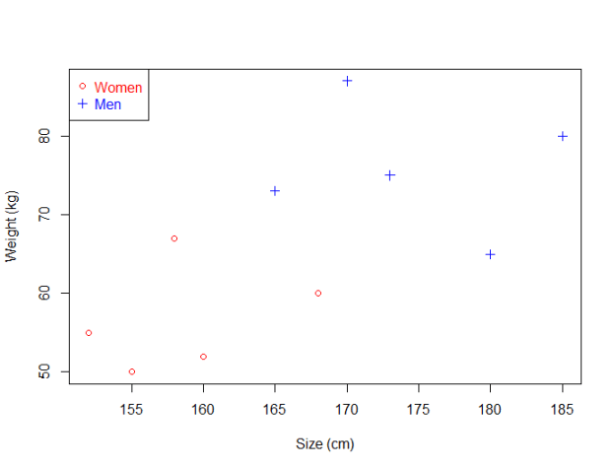
SVM example

Slide 5
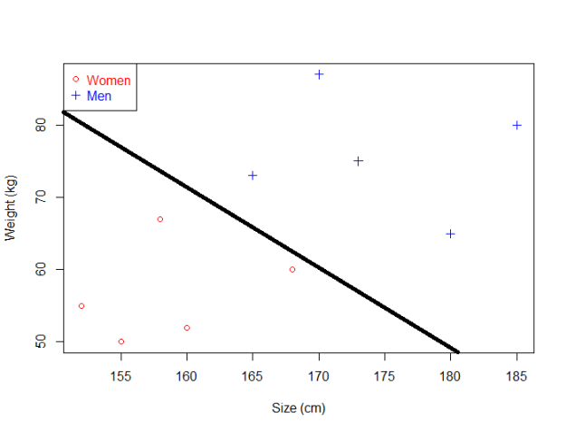
SVM
Separating hyperplane is a hyperplane that has vectors of each class on each side of it.
If such a plane exists, the training set is called separable, otherwise it is inseparable

Slide 6
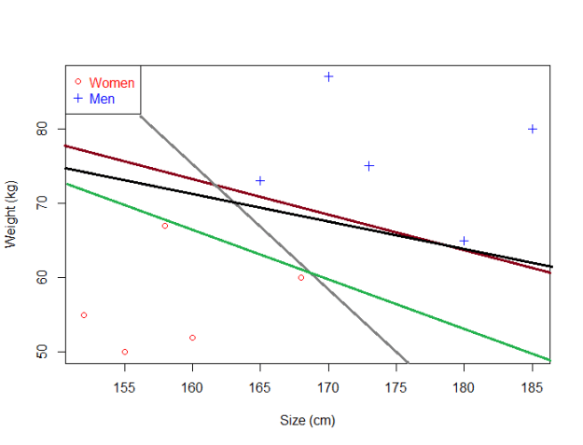
SVM
In a separable case, there are normally more than one possible separating hyperplane. Which one to choose? What is the right criterion?

Slide 7
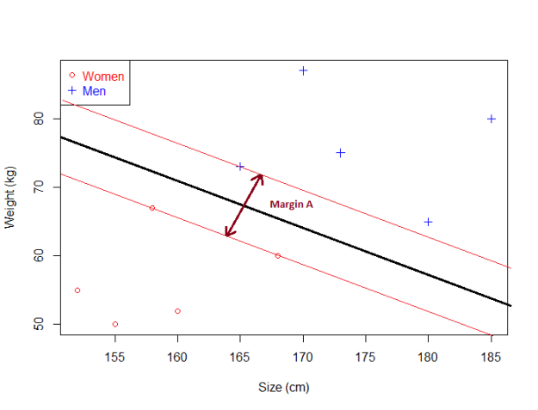
SVM margin
In a separable case, we can compute the distance between the hyperplane and the closest data point. Once we have this value, if we double it we will get what is called the margin.
Basically the margin is a no man's land. There will never be any data point inside the (hard) margin.

Slide 8
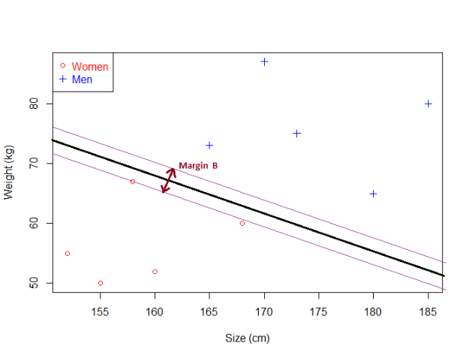
SVM margin
As you can see, Margin B is smaller than Margin A.
If an hyperplane is very close to a data point, its margin will be small.
The further an hyperplane is from a data point, the larger its margin will be.
This means that the optimal hyperplane will be the one with the biggest margin.
That is why the objective of the SVM is to find the optimal separating hyperplane which maximizes the margin of the training data.

Slide 9
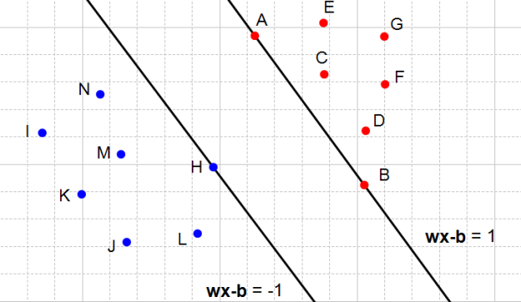
SVM
Support vectors are points that lie on the margins.
Support vectors uniquely identify the separating hyperplane (or decision boundary).
It can be proved that in any separable case there are at least two support vectors.
What does the number (or rather fraction) of support vectors tell us about the training set?

Slide 10
SVM
Inseparable case
There is no decision boundary, no matter how narrow the margins!
Solution: soft margins.
Points are now allowed between the margins. The margins around the decision boundary are taken such, that they include all the misclassified points inside the margins, and no misclassified points are outside the margins.
Obviously, we want to draw the decision boundary and the margins so that the number of misclassified points is minimized.
This may not give a unique solution.
So another loss function is normally chosen where the misclassified points are weighted by their distance to the decision boundary. This produces a unique and most generalizable decision boundary.

Slide 11
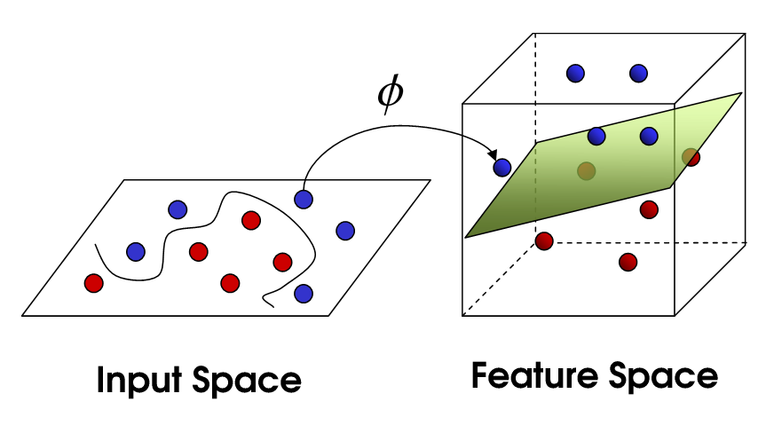
Kernel Trick

Slide 12
Nonlinear Transformation with Kernels
Nonlinear Transformation with Kernels
Some binary classification problems do not have a simple hyperplane as a useful separating criterion. For those problems, there is a variant of the mathematical approach that retains nearly all the simplicity of an SVM separating hyperplane.
The mathematical approach using kernels relies on the computational method of hyperplanes. All the calculations for hyperplane classification use nothing more than dot products. Therefore, nonlinear kernels can use identical calculations and solution algorithms, and obtain classifiers that are nonlinear. The resulting classifiers are hypersurfaces in some space S, but the space S does not have to be identified or examined.

Slide 13
Nonlinear Transformation with Kernels
There is a class of functions G(x₁,x₂) with the following property. There is a linear space S and a function φ mapping x to S such that
G(x₁,x₂) = <φ(x₁),φ(x₂)>.
The dot product takes place in the space S.
This class of functions includes:
Polynomials: For some positive integer p,
G(x₁,x₂) = (1 + x₁′x₂)^{p}.
Radial basis function (Gaussian):
G(x₁,x₂) = exp(–∥x₁–x₂)∥²).
Multilayer perceptron or sigmoid (neural network): For a positive number p₁ and a negative number p₂,
G(x₁,x₂) = tanh(p₁x₁′x₂ + p₂).

Slide 14
Training SVM Classifier
Train, and optionally cross validate, an SVM classifier using fitcsvm. The most common syntax is:
SVMModel = fitcsvm(X,Y,'KernelFunction','rbf',...
'Standardize',true,'ClassNames',{'negClass','posClass'});

Slide 15
Training SVM Classifier
X — Matrix of predictor data, where each row is one observation, and each column is one predictor.
Y — Array of class labels with each row corresponding to the value of the corresponding row in X. Y can be a categorical, character, or string array, a logical or numeric vector, or a cell array of character vectors.

Slide 16
Training SVM Classifier
X — Matrix of predictor data, where each row is one observation, and each column is one predictor.
Y — Array of class labels with each row corresponding to the value of the corresponding row in X. Y can be a categorical, character, or string array, a logical or numeric vector, or a cell array of character vectors.

Slide 17
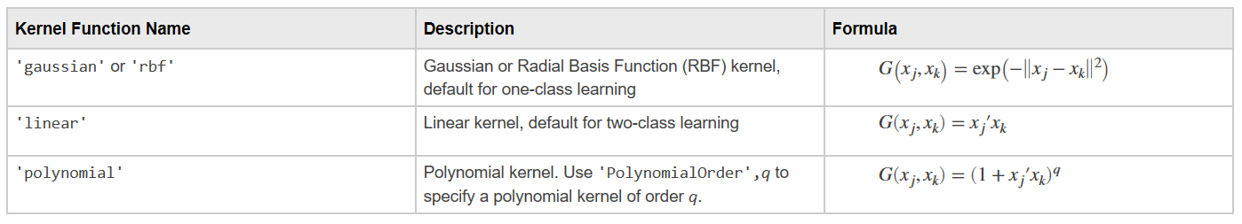
Learning Options
KernelFunction — The default value is 'linear' for two-class learning, which separates the data by a hyperplane. The value 'gaussian' (or 'rbf') is the default for one-class learning, and specifies to use the Gaussian (or radial basis function) kernel. An important step to successfully train an SVM classifier is to choose an appropriate kernel function.

Slide 18
Learning Options
Standardize — Flag indicating whether the software should standardize the predictors before training the classifier.
If you set 'Standardize',true in fitcsvm when training SVMModel, then the software standardizes the columns of the predictor data using the corresponding means in SVMModel.Mu and the standard deviations in SVMModel.Sigma.
The optimal hyperplane is influenced by the scale of the input features and it is therefore recommended that data be standardized (mean 0, var 1) prior to SVM model training.

Slide 19
Training SVM Classifier
The resulting, trained model contains the optimized parameters from the SVM algorithm, allowing to classify new data.

Slide 20
Classification score
The SVM classification score for classifying observation x is the signed distance from x to the decision boundary ranging from -∞ to +∞. A positive score for a class indicates that x is predicted to be in that class. A negative score indicates otherwise.

Slide 21
Classifying New Data with an SVM Classifier
Classify new data using predict. The syntax for classifying new data using a trained SVM classifier (SVMModel) is:
[label,score] = predict(SVMModel,newX);
The resulting vector, label, represents the classification of each row in X. score is an n-by-2 matrix of soft scores. Each row corresponds to a row in X, which is a new observation. The first column contains the scores for the observations being classified in the negative class, and the second column contains the scores observations being classified in the positive class.

